Slide 1
Cryptography and Network Security Lab
Lab-2
Dr. Sunil Gupta
Professor- SoCS, UPES

Slide 2
Breaking of Caesar's Cipher :
Obviously, it had two weaknesses.
The first was that the algorithm was not particularly strong.
If English text was being encrypted, then it would be relatively simple to compare the frequency of letters in the cipher text against the frequency of letters in standard English.
Statistics would soon reveal patterns that pointed out the probable plain text letter associated with each cipher text letter.
Once a single association was found the entire algorithm could be cracked.
No message would be secure.

Slide 3
Caesar Cipher
Julius Caesar used additive ciphers to communicate with his officers. He used 3 as the key value.
Cryptanalysis
Additive ciphers are vulnerable to ciphertext-only attacks using exhaustive key searches.
The key domain is very small. (Example: 26 keys, excluding ZERO, we have 25 keys)
Eve can launch a brute-force attack on the ciphertext using these 25 keys.

Slide 4
Additive ciphers can also be subjected to statistical attacks.
If Eve, gets hold of a long text then the commonly repeated words can be identified and analysed.

Slide 5
Frequency analysis
Frequency analysis : Caesar's Cipher is so vulnerable to frequency analysis. It is because there is a one-to-one relationship between each letter. If a sufficiently large ciphertext is given, the plaintext can be found out by frequency analysis.
If there is a sufficiently large ciphertext, it would be solved by comparing the frequency of letters in the cipher text against the frequency of letters in standard English.
If the frequency of the letter in the cipher text is almost the same as the frequency of letters in standard English, we can find out which letter is substituted for the letter in ciphertext. Then the message would be decrypted.

Slide 6
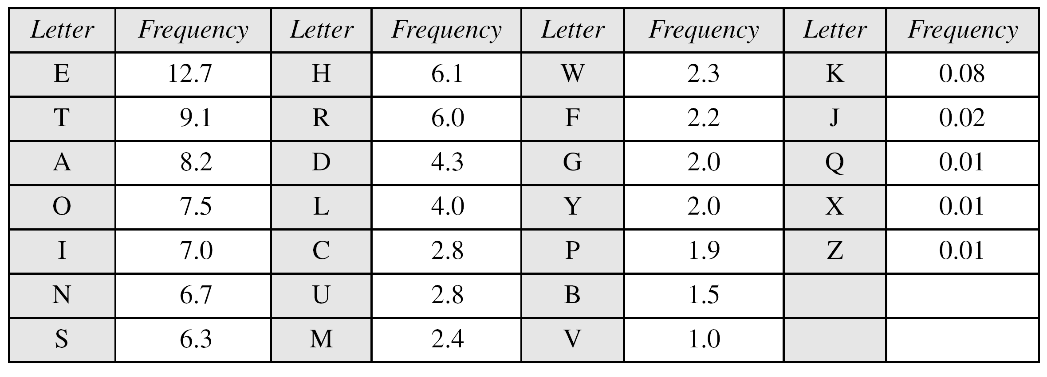

Slide 7
Vigenere Cipher
Example
We can encrypt the message “She is listening” using the 6-character keyword “PASCAL”.

Slide 8
Let us see how we can encrypt the message “She is listening” using the 6-character keyword “PASCAL”. The initial key stream is (15, 0, 18, 2, 0, 11). The key stream is the repetition of this initial key stream (as many times as needed).

